Slide 1
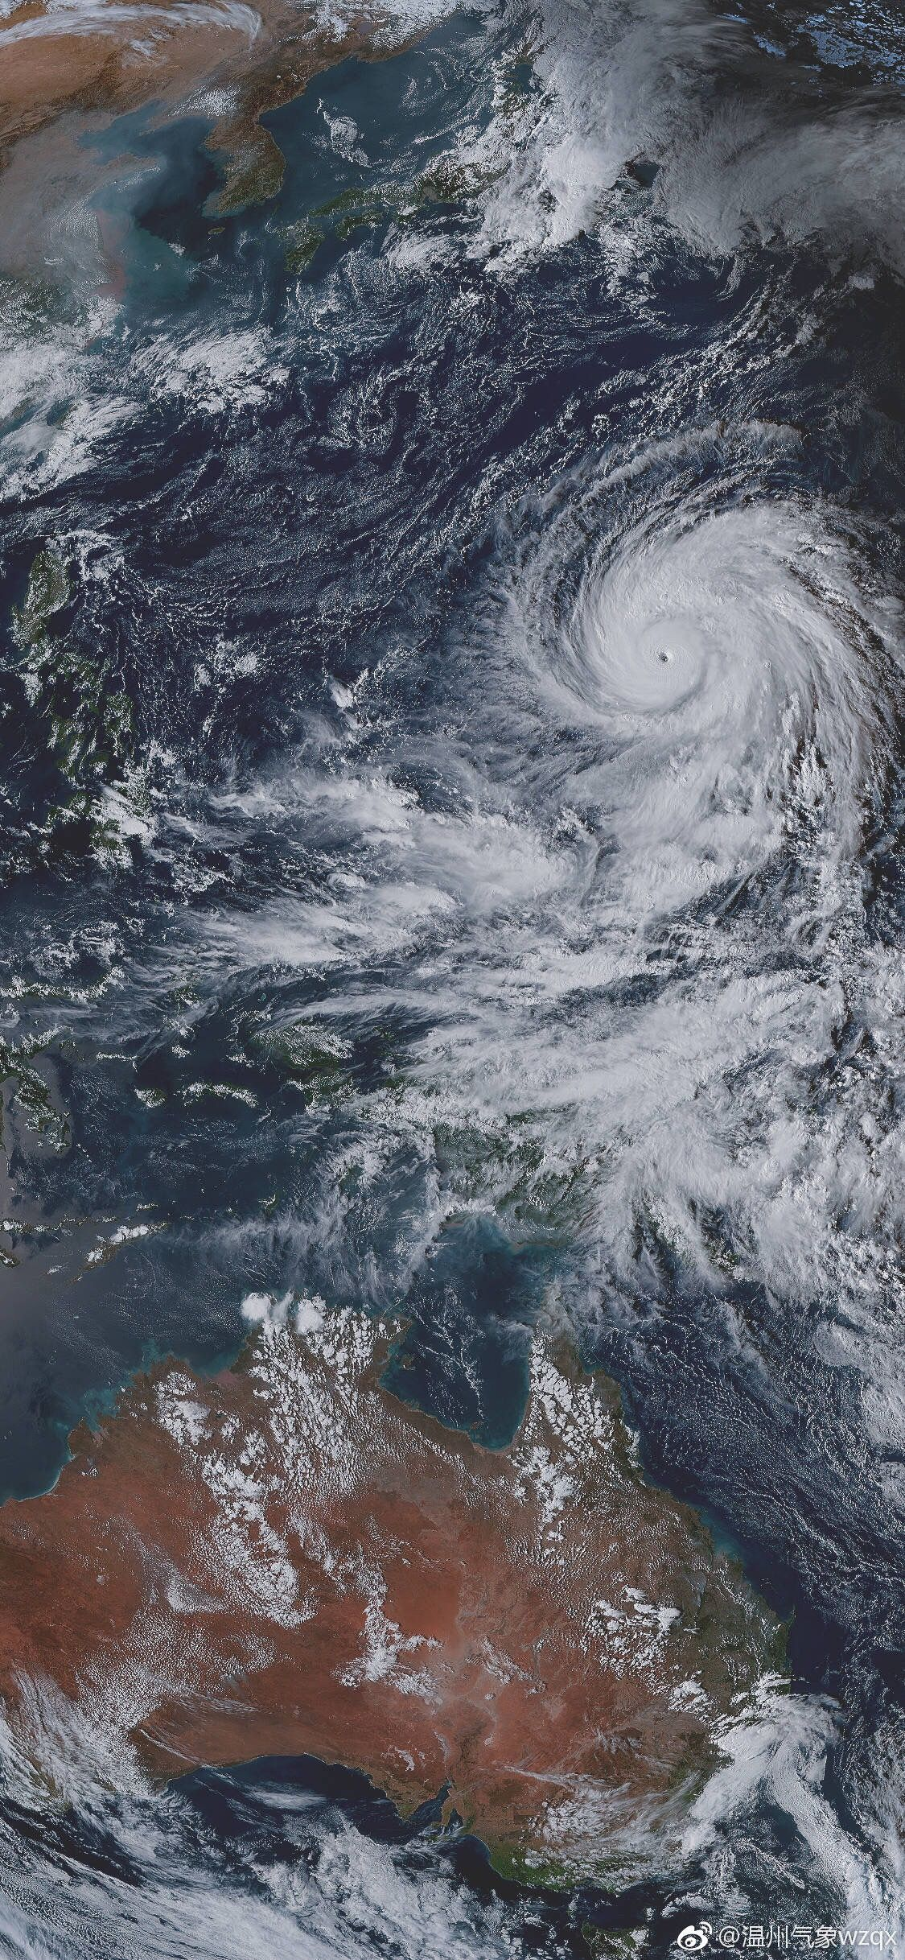
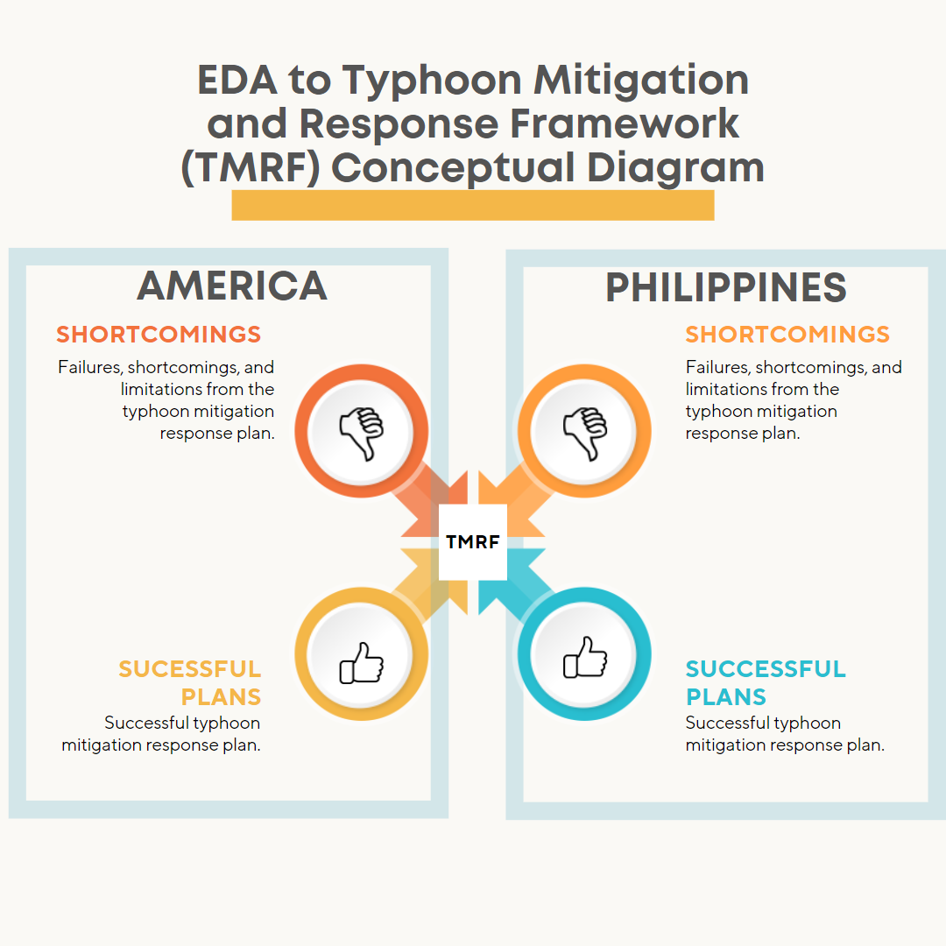
EDA to Typhoon Mitigation and Response Framework (TMRF)
Presented by:
TEAM TYPHOON ANALYST
Alvaro, Gabriel Edrian
Palis, John Arthur
Alangilan, Christine Joy
Guerra, Marian

Slide 2
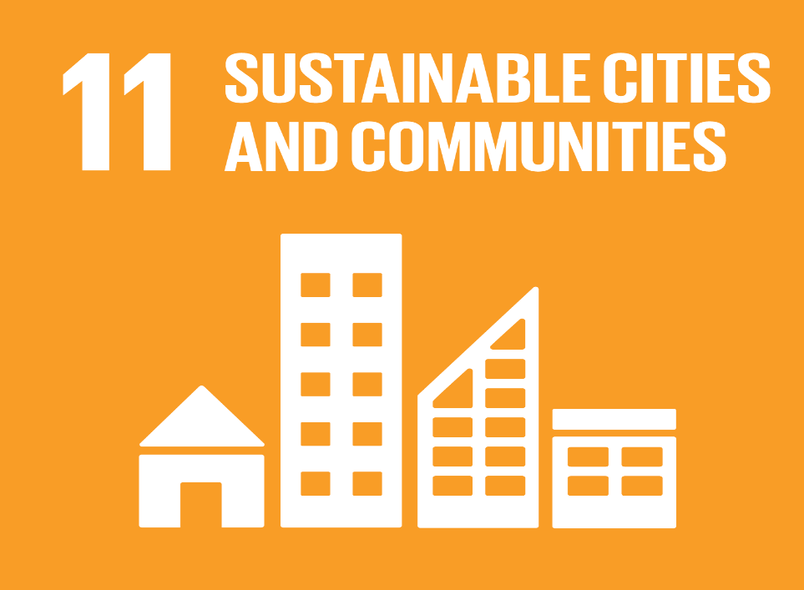


Goal 11: Sustainable Cities and Communities
Sustainable Development Goals
It stives to mitigate the negative consequences of natural catastrophes like typhoons.
Goal 13: Climate Action
It stives to take immediate action to address climate change and its consequences.
Goal 15: Life on Land
It seeks to manage forest sustainability, prevent desertification, halt and reverse land degradation, and halt biodiversity loss.

Slide 3
DID YOU KNOW?
20
APPROXIMATELY
Twenty tropical cyclones pass through the Philippine Area of Responsibility per year

Slide 4

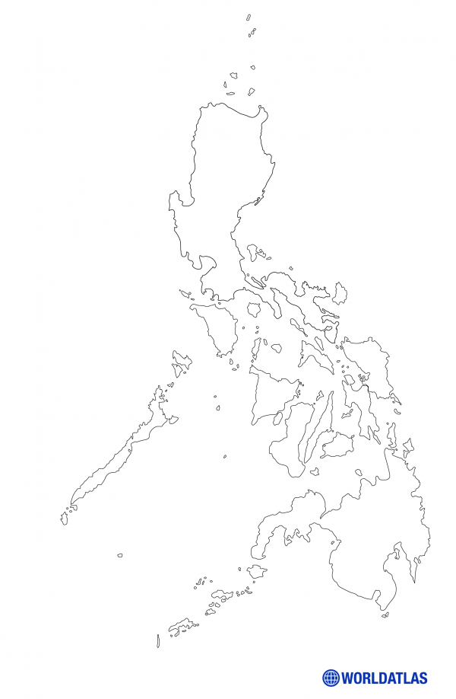
EDA TO TMRF INTRODUCTION
The Philippines' apparent vulnerability to natural disasters emerges from its geographic location within the Pacific Ring of Fire.

Slide 5
PROBLEM STATEMENT
The primary issue addressed by this project is the lack of a mitigation and response framework among the cities and municipalities located throughout the Philippine archipelago.

Slide 6



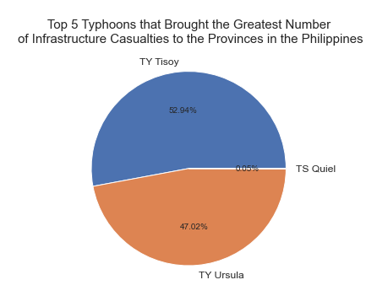
TYPHOON TISOY
68,104
TYPHOON TISOY TYPHOON URSULA
TYPHOON QUIEL
Totally Damaged Houses

Slide 7

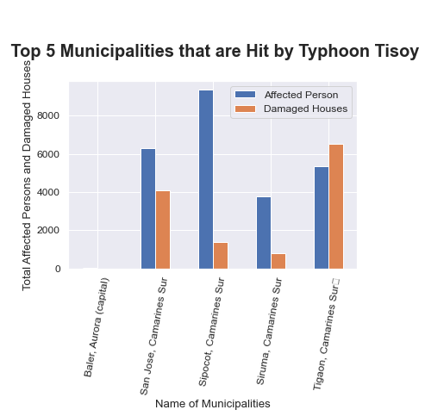
OBJECTIVES
SIPOCOT, CAMARINES SUR
TYPHOON TISOY TYPHOON URSULA
TYPHOON QUIEL
136.0
Totally Damaged Houses
Humanitarian Data Exchange Data set about Philippines (2019)
Objective 1
Objective 2
Objective 3
The Centre for Research on the Epidemiology of Disasters' Data set about the American Typhoons (2000-2022)

Slide 8
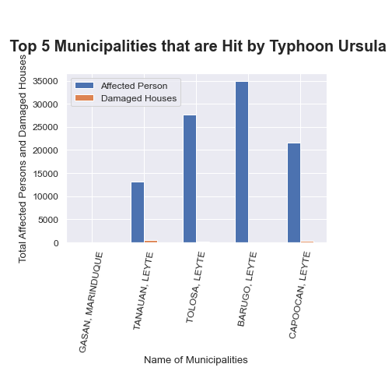


OBJECTIVES
34932.0
34932.0
Humanitarian Data Exchange Data set about Philippines (2019)
Objective 1
Objective 2
Objective 3
The Centre for Research on the Epidemiology of Disasters' Data set about the American Typhoons (2000-2022)
Barugo, Leyte
34932.0
TYPHOON URSULA
Barugo, Leyte
Total Affected Persons
Most affected Municipality

Slide 9
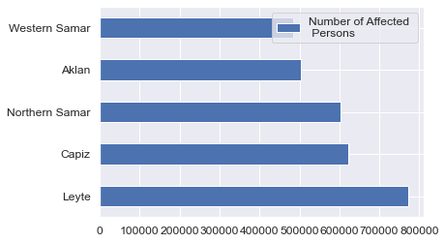


OBJECTIVES
Humanitarian Data Exchange Data set about Philippines (2019)
Objective 1
Objective 2
Objective 3
The Centre for Research on the Epidemiology of Disasters' Data set about the American Typhoons (2000-2022)
LEYTE
WESTERN SAMAR
772162.0
483308.0
AFFECTED INDIVIDUALS
AFFECTED INDIVIDUALS

Slide 10
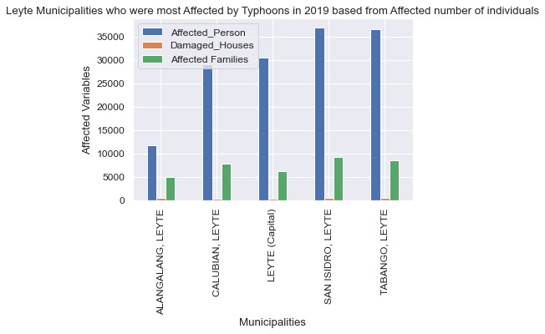
OBJECTIVES
Humanitarian Data Exchange Data set about Philippines (2019)
Objective 1
Objective 2
Objective 3
The Centre for Research on the Epidemiology of Disasters' Data set about the American Typhoons (2000-2022)
SAN, ISIDRO, LEYTE
ALANGALANG, LEYTE
36980.0
11680.0
AFFECTED INDIVIDUALS
AFFECTED INDIVIDUALS

Slide 11
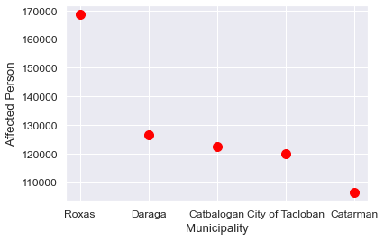
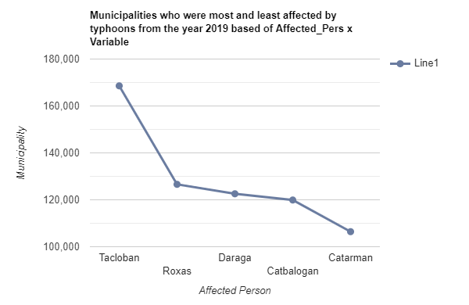
OBJECTIVES
Humanitarian Data Exchange Data set about Philippines (2019)
Objective 1
Objective 2
Objective 3
The Centre for Research on the Epidemiology of Disasters' Data set about the American Typhoons (2000-2022)
TOP 5
MUNICIPALITIES
Who had the most affected individuals in the year 2019

Slide 12
OBJECTIVES
Humanitarian Data Exchange Data set about Philippines (2019)
The Centre for Research on the Epidemiology of Disasters' Data set about the American Typhoons (2000-2022)
Objective 1
Objective 2
Objective 3
Objective 4
Objective 5

Slide 13
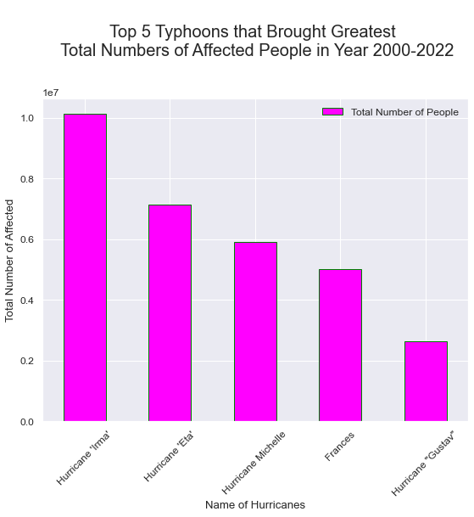
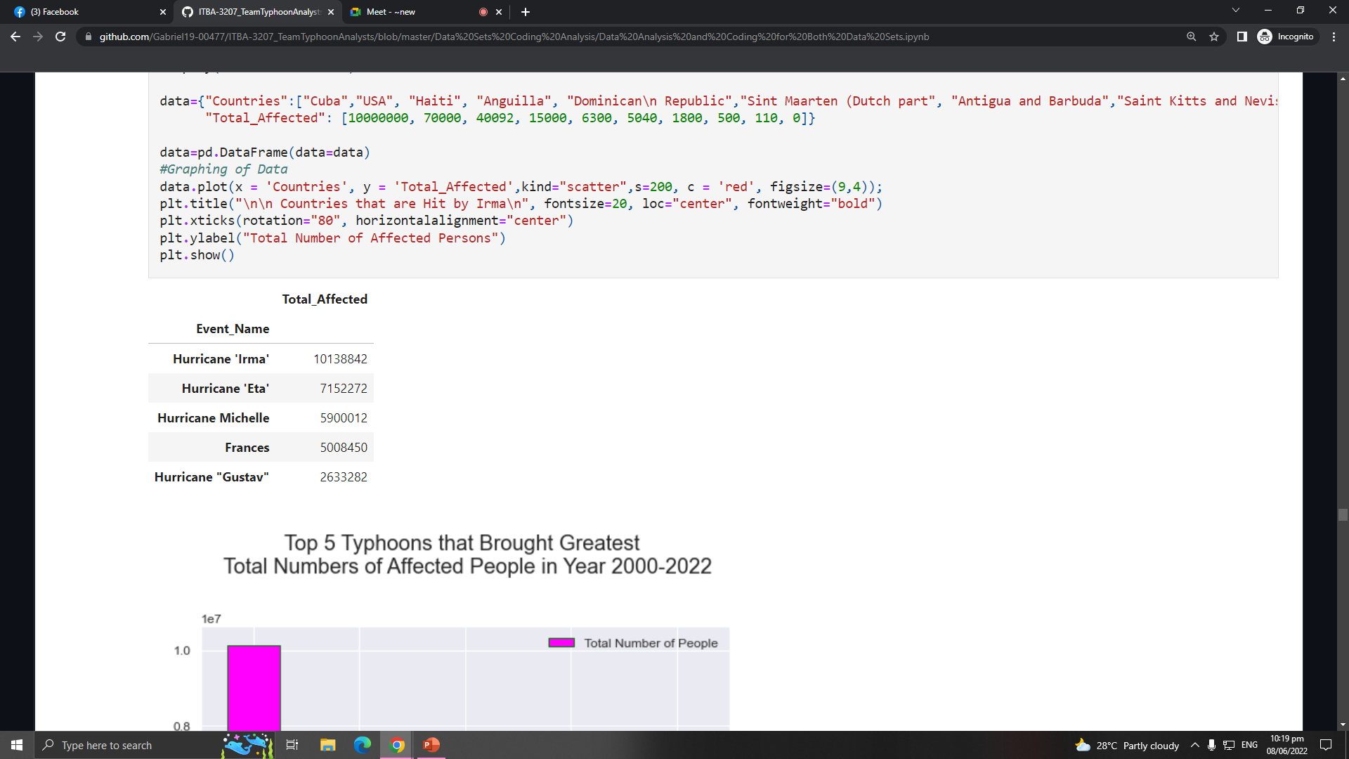

OBJECTIVES
Humanitarian Data Exchange Data set about Philippines (2019)
The Centre for Research on the Epidemiology of Disasters' Data set about the American Typhoons (2000-2022)
Objective 1
Objective 2
Objective 3
Objective 4
Objective 5
HURRICANE
IRMA

Slide 14
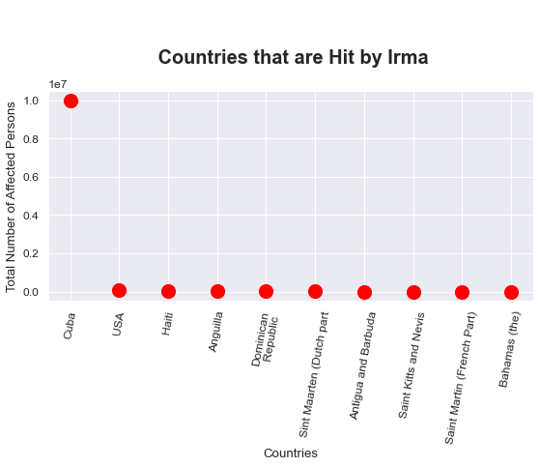

OBJECTIVES
Humanitarian Data Exchange Data set about Philippines (2019)
The Centre for Research on the Epidemiology of Disasters' Data set about the American Typhoons (2000-2022)
Objective 1
Objective 2
Objective 3
Objective 4
Objective 5
10M
HURRICANE IRMA
TOTAL AFFECTED PERSON IN CUBA BY THE HURRICANE IRMA

Slide 15
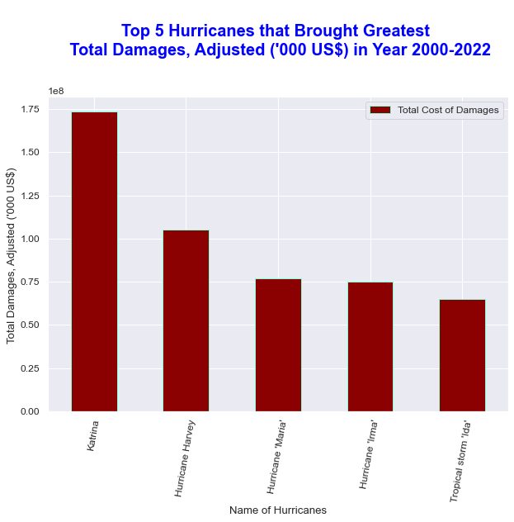
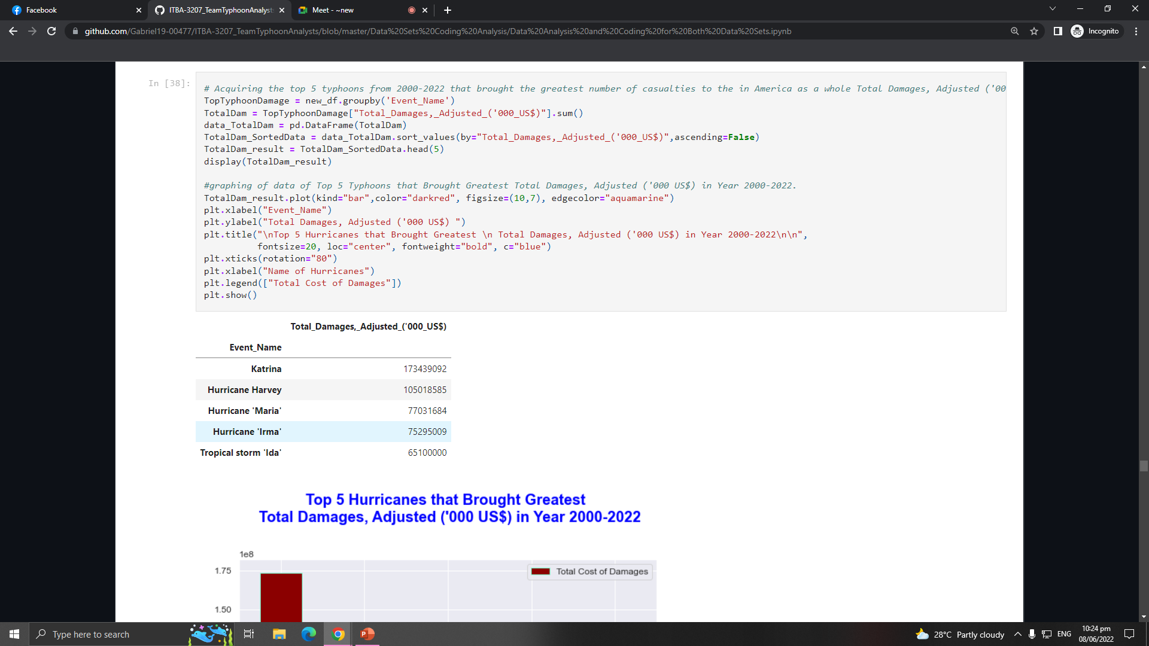
OBJECTIVES
Humanitarian Data Exchange Data set about Philippines (2019)
The Centre for Research on the Epidemiology of Disasters' Data set about the American Typhoons (2000-2022)
Objective 1
Objective 2
Objective 3
Objective 4
Objective 5
HURRICANE
KATRINA

Slide 16
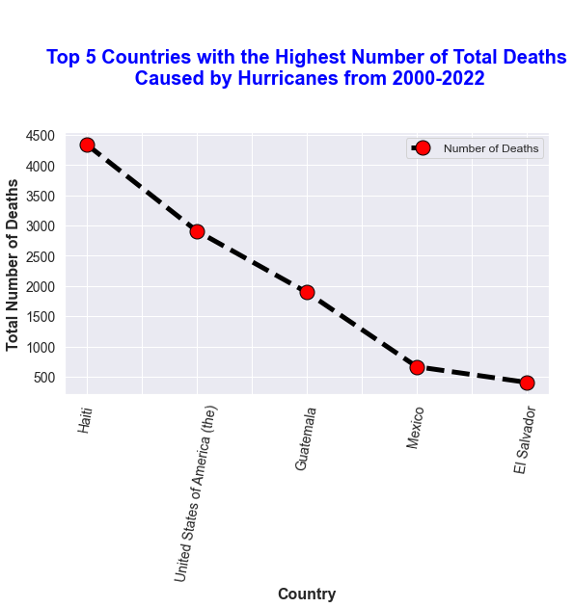
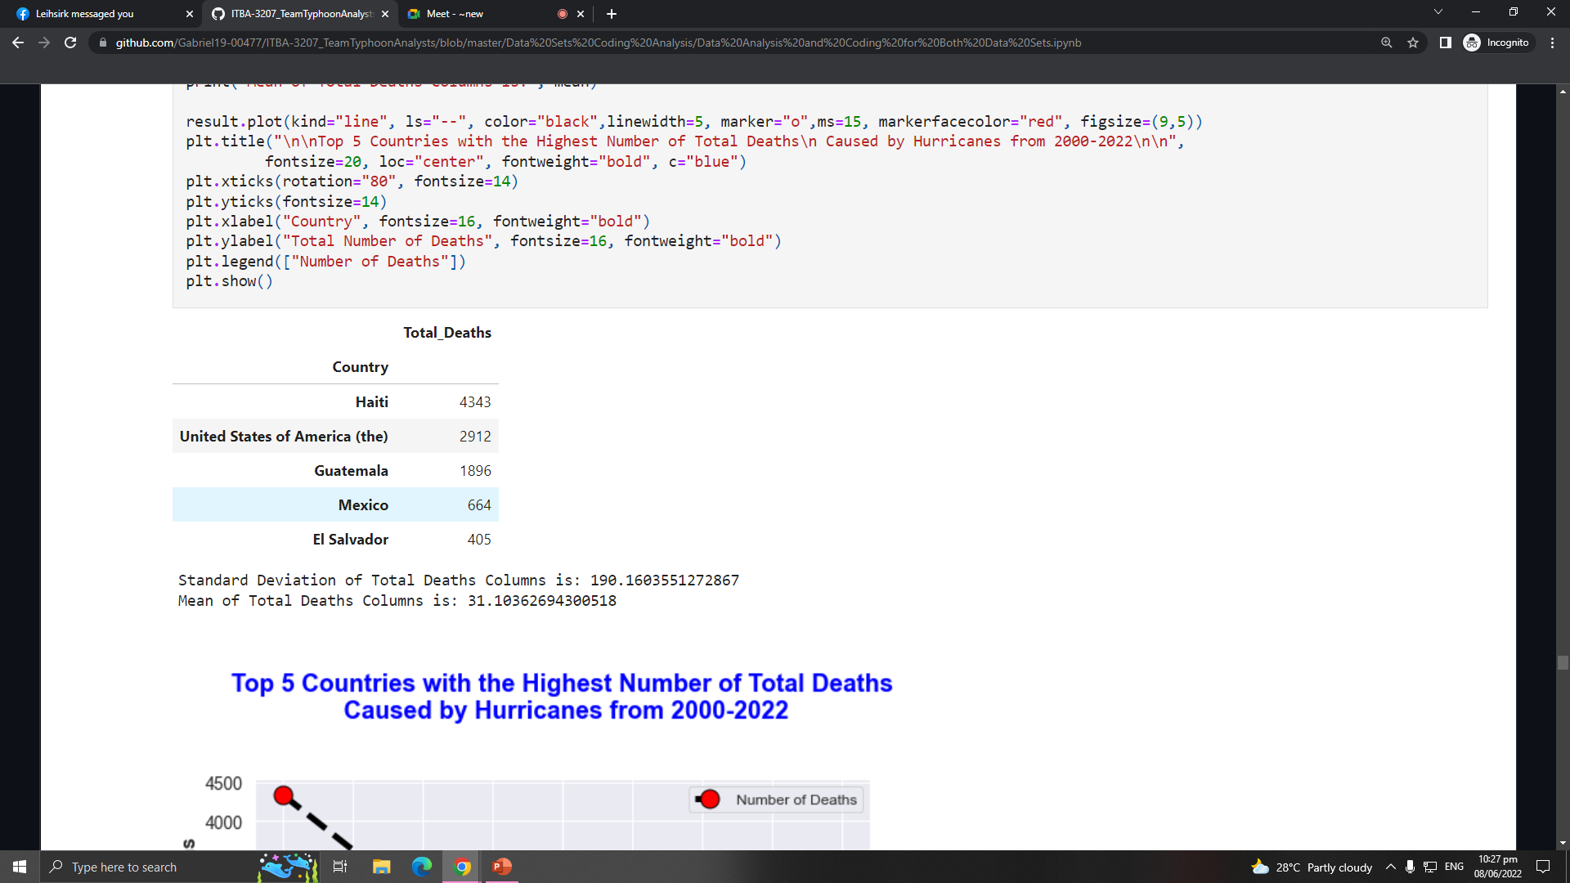
OBJECTIVES
Humanitarian Data Exchange Data set about Philippines (2019)
The Centre for Research on the Epidemiology of Disasters' Data set about the American Typhoons (2000-2022)
Objective 1
Objective 2
Objective 3
Objective 4
Objective 5
HAITI
4343
TOTAL DEATHS

Slide 17
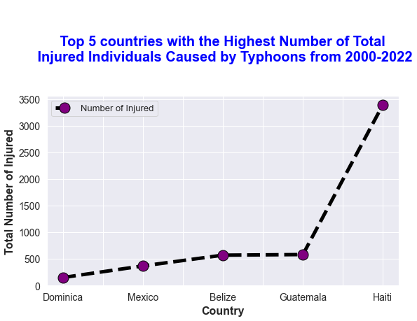
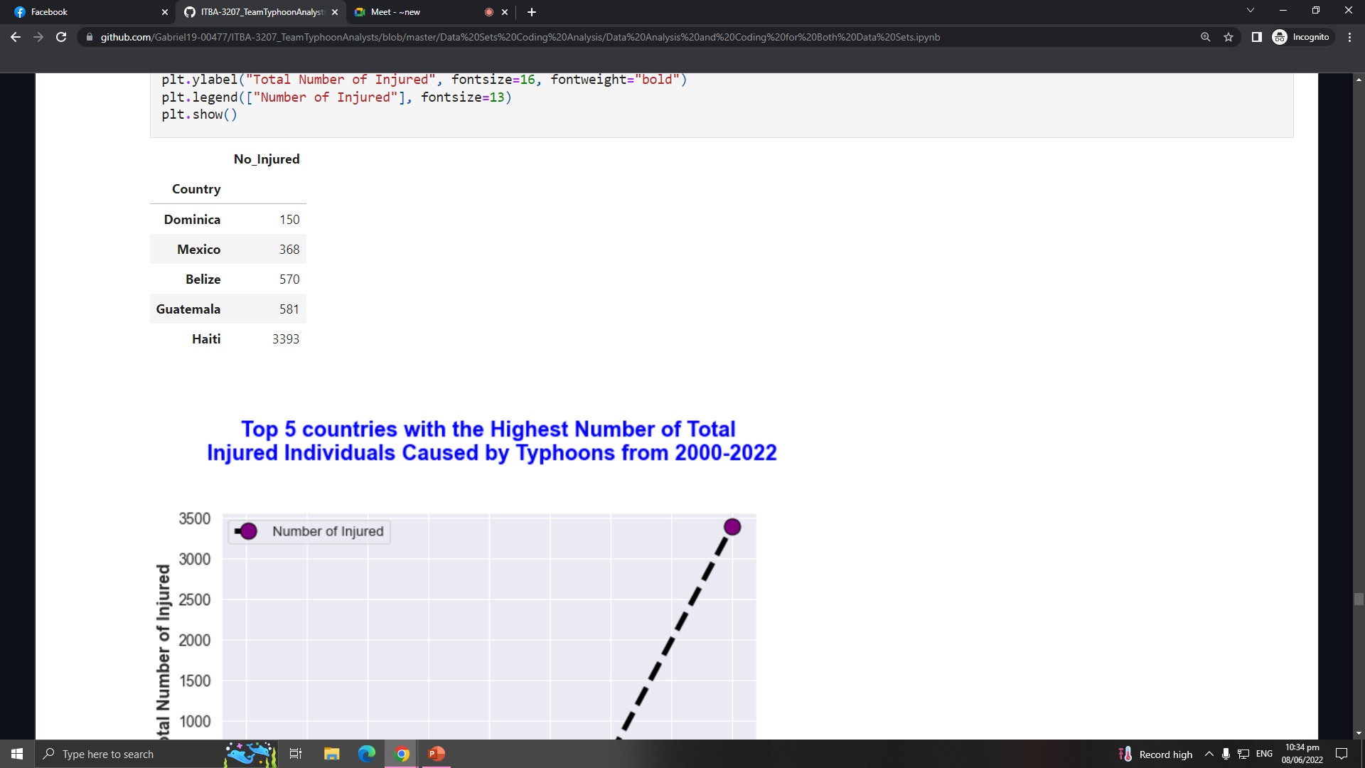

OBJECTIVES
Humanitarian Data Exchange Data set about Philippines (2019)
The Centre for Research on the Epidemiology of Disasters' Data set about the American Typhoons (2000-2022)
Objective 1
Objective 2
Objective 3
Objective 4
Objective 5
3393
150
NUMBER OF INJURED IN HAITI
NUMBER OF INJURED IN DOMINICA

Slide 18
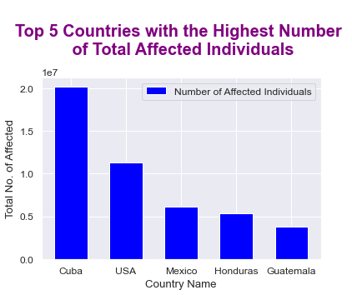
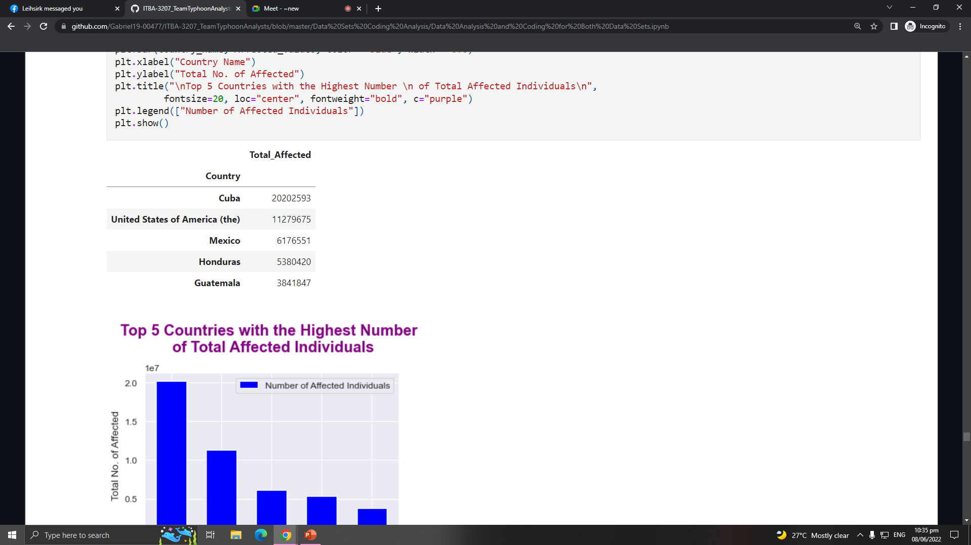
OBJECTIVES
Humanitarian Data Exchange Data set about Philippines (2019)
The Centre for Research on the Epidemiology of Disasters' Data set about the American Typhoons (2000-2022)
Objective 1
Objective 2
Objective 3
Objective 4
Objective 5
20202593.0
TOTAL AFFECTED INDIVIDUALS IN CUBA

Slide 19
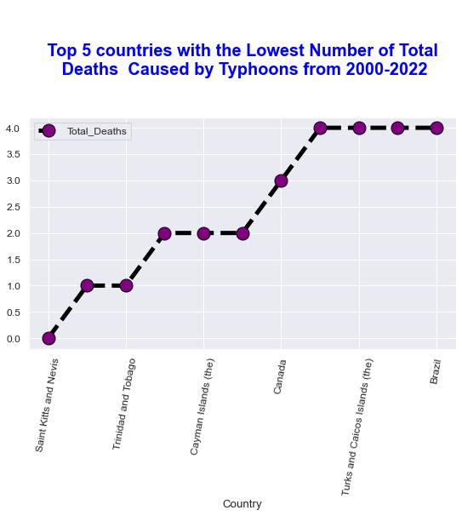
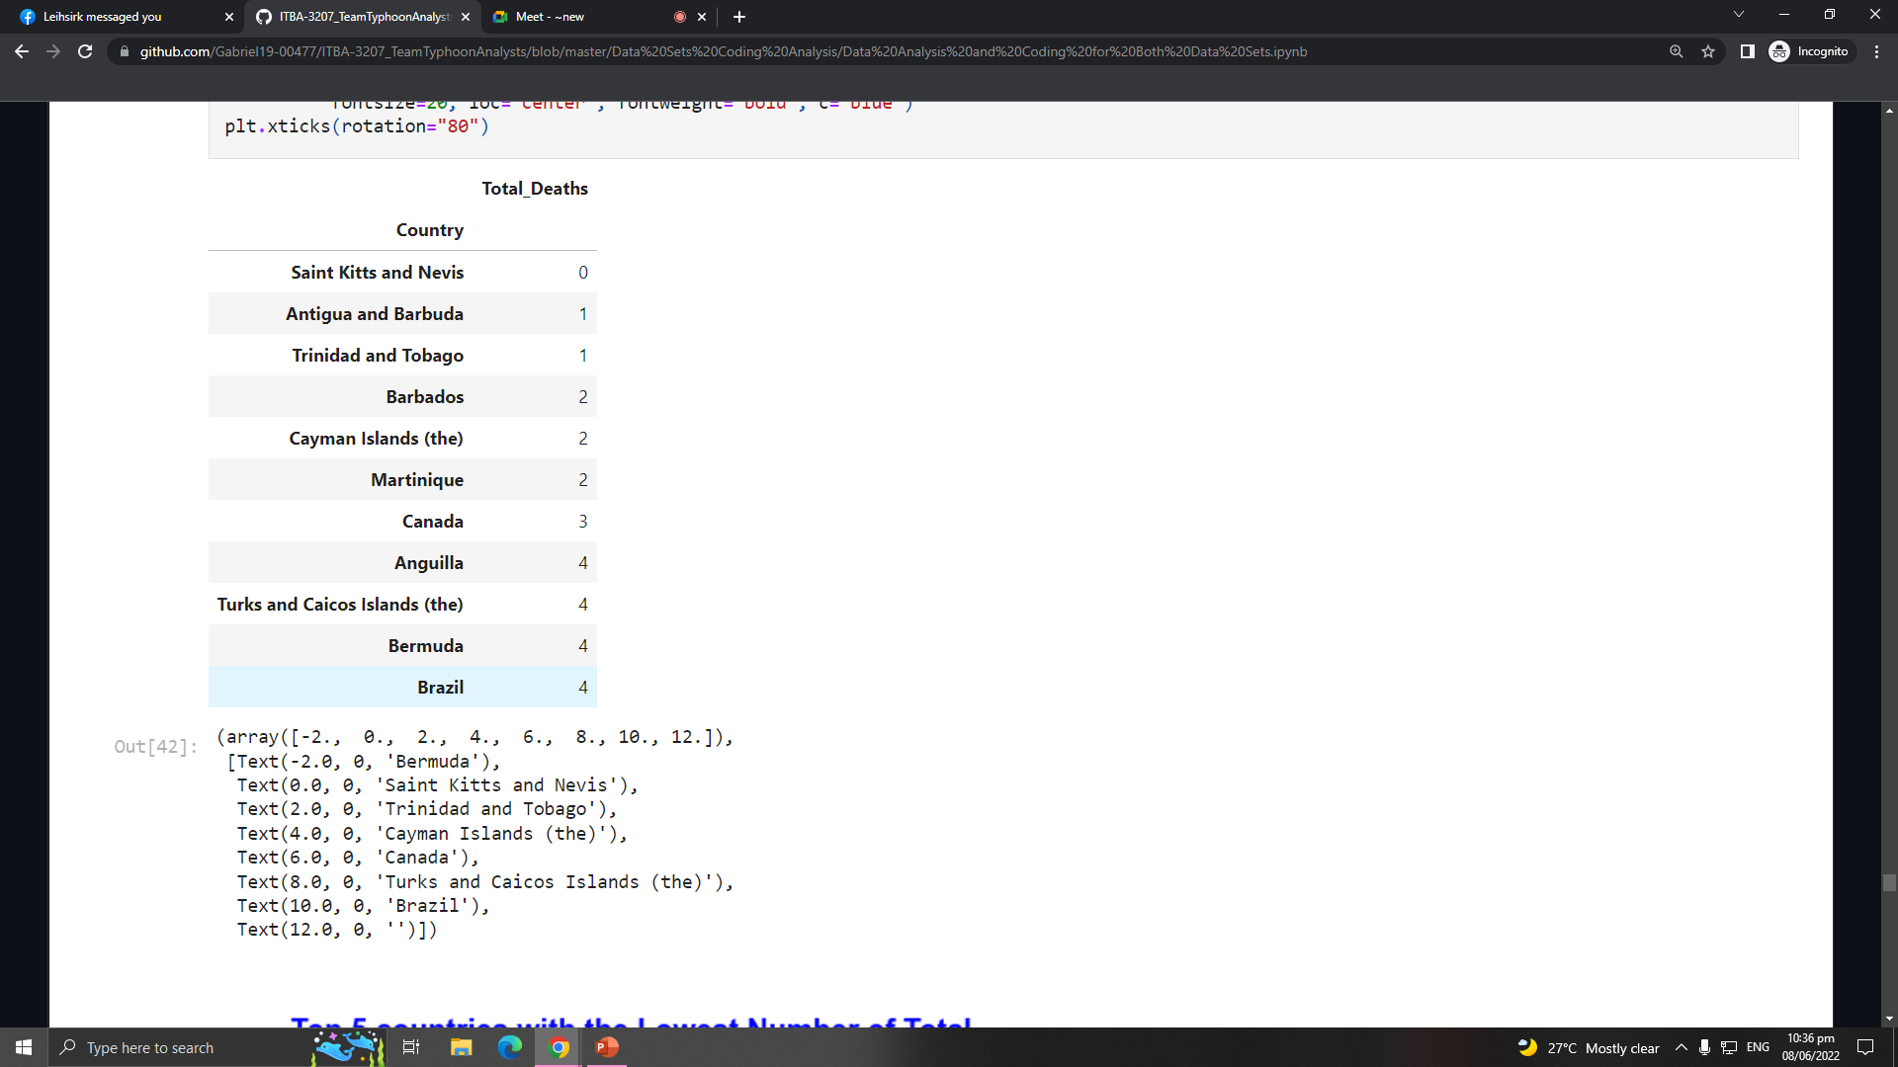
OBJECTIVES
Humanitarian Data Exchange Data set about Philippines (2019)
The Centre for Research on the Epidemiology of Disasters' Data set about the American Typhoons (2000-2022)
Objective 1
Objective 2
Objective 3
Objective 4
Objective 5
Saint Kitts and Nevis
Lowest Number of Total Deaths

Slide 20
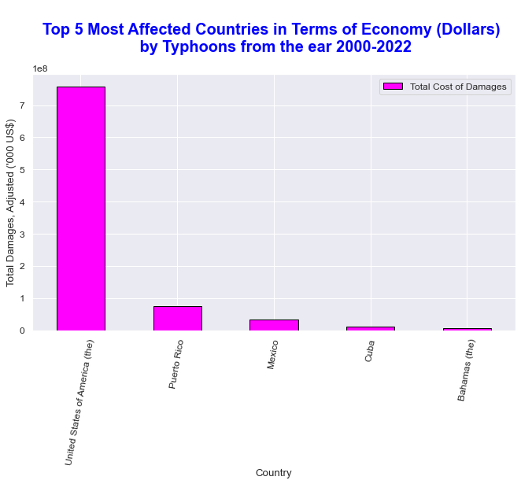
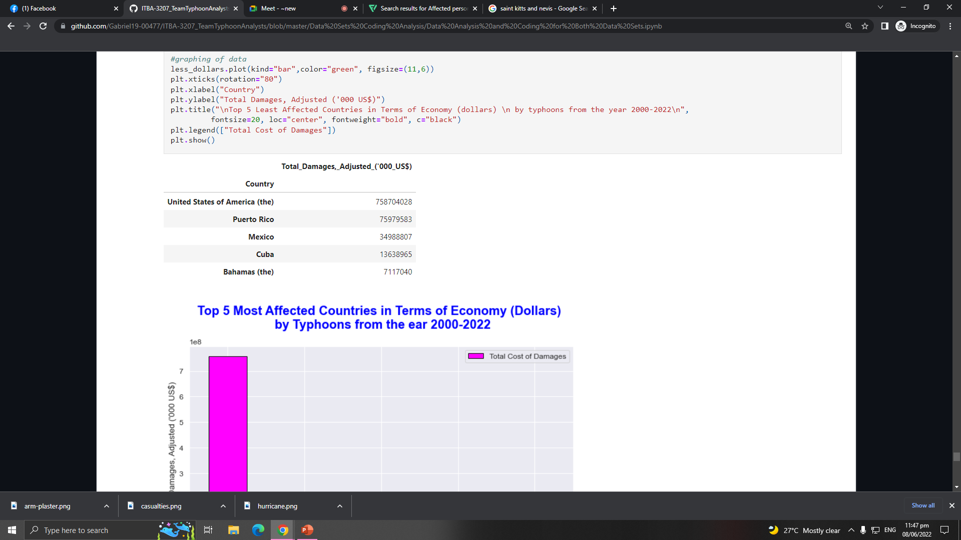
OBJECTIVES
Humanitarian Data Exchange Data set about Philippines (2019)
The Centre for Research on the Epidemiology of Disasters' Data set about the American Typhoons (2000-2022)
Objective 1
Objective 2
Objective 3
Objective 4
Objective 5
USA
MOST AFFECTED COUNTRY HAVING MORE THAN 700 BILLION TOTAL COST OF DAMAGES

Slide 21
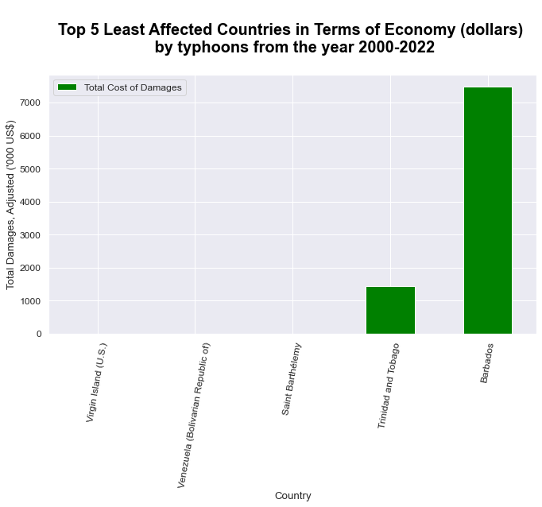
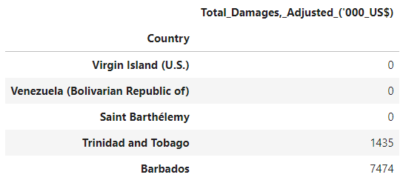
OBJECTIVES
Humanitarian Data Exchange Data set about Philippines (2019)
The Centre for Research on the Epidemiology of Disasters' Data set about the American Typhoons (2000-2022)
Objective 1
Objective 2
Objective 3
Objective 4
Objective 5
Virgin Islands, Venezuela, and Saint Barthelemy
No Record of Total Cost of Damages

Slide 22
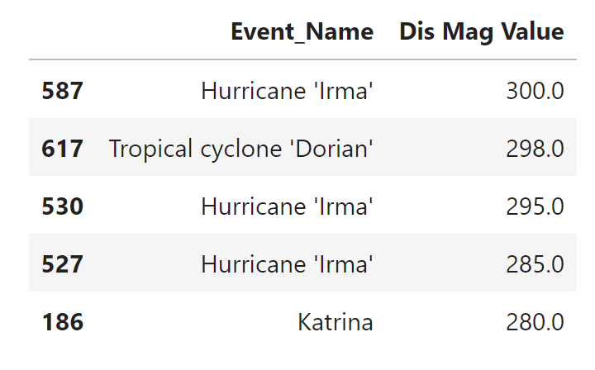
OBJECTIVES
Humanitarian Data Exchange Data set about Philippines (2019)
The Centre for Research on the Epidemiology of Disasters' Data set about the American Typhoons (2000-2022)
Objective 1
Objective 2
Objective 3
Objective 4
Objective 5

Slide 23


Source of Datasets
HDX
An open platform for sharing data across crises and organizations and goal of it to make humanitarian data easy to find and use for analysis.
CRED
The Centre promotes research, training and technical expertise on humanitarian emergencies, particularly in public health and epidemiology.

Slide 25




MEET THE TEAM
TEAM TYPHOON ANALYST
Gabriel Alvaro
Project Manager
John Palis
Presentation Manager
Christine Alangilan
Documentation Director
Marian Guerra
Quality Assurance Analyst

